Slide 1
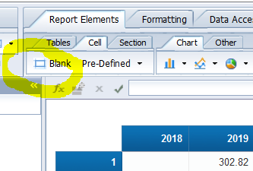
Homework for Monday 19
The next slides will give instructions and reminders about BO Connection and the use of WebI.
Here is the work to do by Friday morning :
The manager for the ‘Fresh food’ product family want to compare the Sales Amount in 2021 to the ones in 2020.
Create the relevant query, run it and save your report into your ‘Favorites Folder’ (then, save as often as you can, it’s just a web client…).
Create a table of figures to display the total Sales Amount per year and how it splits into Sectors.
Display the same data in a chart. Choose the chart type and options you consider fittest (explore these right-click commands: Turn Into, Assign Data, Chart Format).
Beautify your report so it is the most easy to read and understand, using all features and options you like. Feel free to include titles and/or comments in Blank Cells (Report Element > Cell > Blank).
Why is your Sales Amount smaller in 2021? Explore data and answer with a table and/or chart as evidence.
Mandatorily, include on the report the names for both students of the group (e.g. in a blank cell).
Save your eventual report into your ‘Favorites Folder’. If you have saved several versions, please make obvious which one I should grade.
Please e-mail me quickly if you cannot access the server or for bugs.

Slide 3
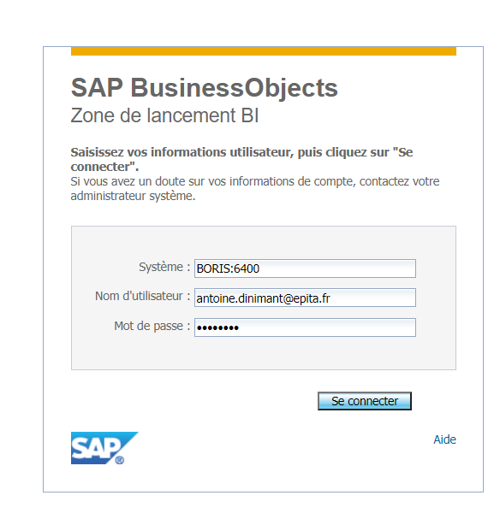
Connect to BO platform
With a web browser, go to http://90.92.159.129:8080/BOE/BI, and connect with these parameters:
System: BORIS:6400 (should be present by default)
User name : the one I’ve emailed to your group
Password: the one I’ve emailed to your group

Slide 4
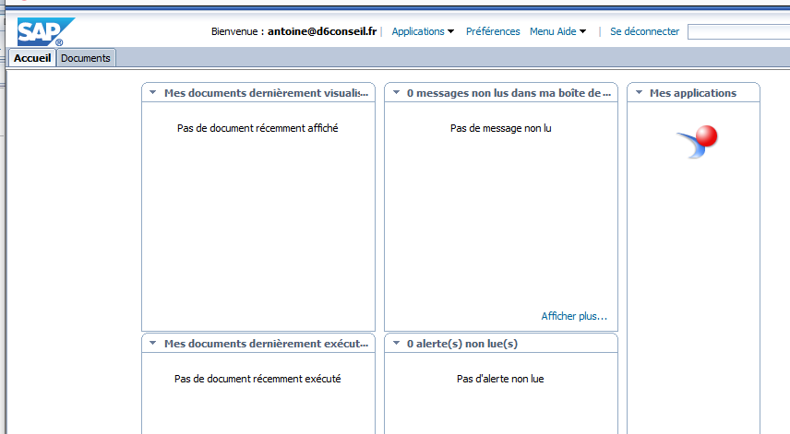
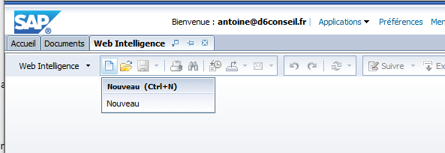
Create a WebI document (1)
Click the WebI icon on the top right corner of the homepage
Click on New / Nouveau

Slide 5
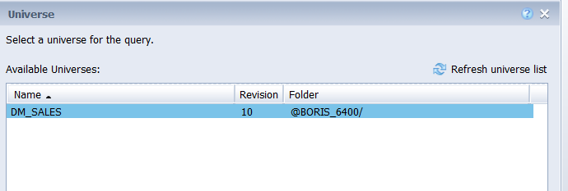
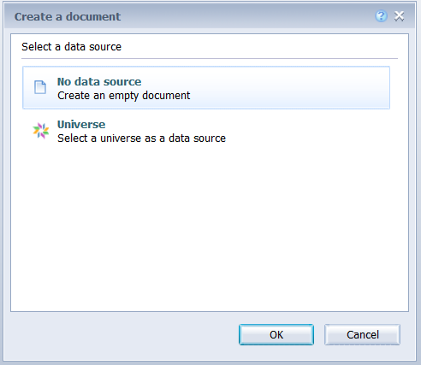
Create a WebI document (2)
Choose Universe…
… then the DM_SALES universe

Slide 6
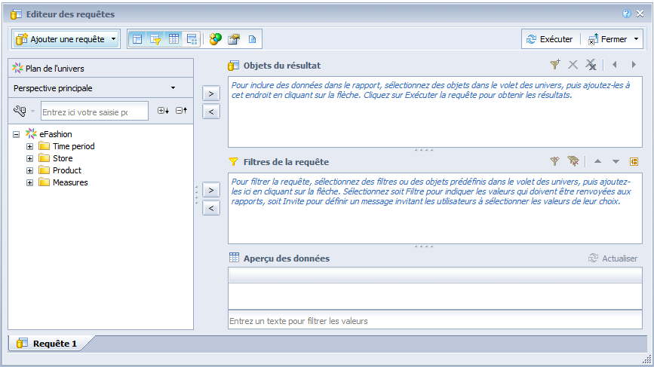
Create your query
When your query is ready, click on Run Query / Exécuter.

Slide 7
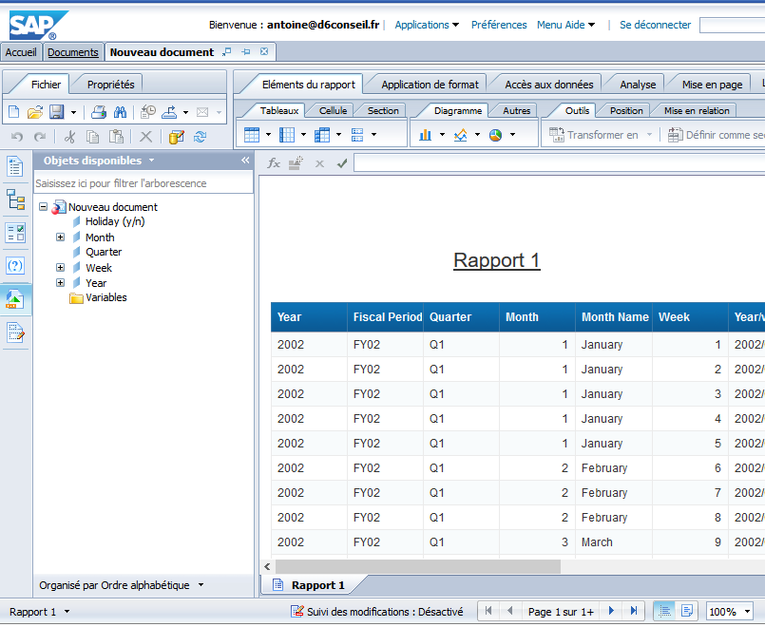
Main commands
Save your doc (to be done very frequently)
Go to query panel
Display available data objects from your query
With a right click, create or manage tabs (reports).

Slide 8
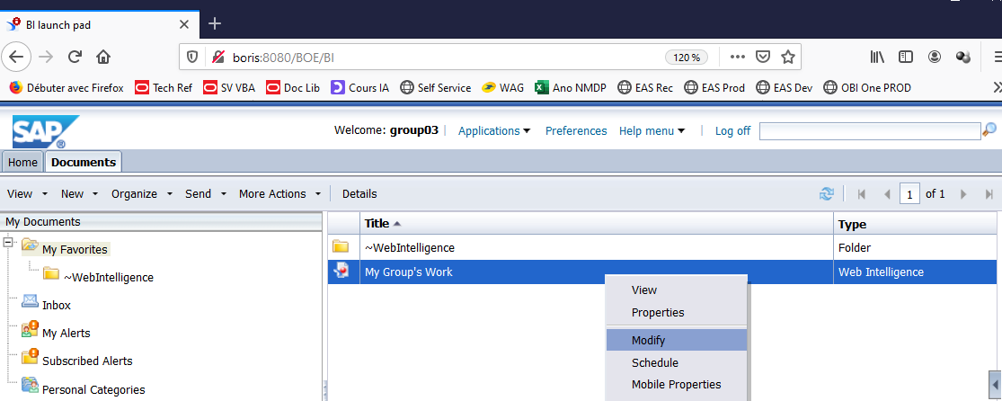
Re-open a saved document
On the Documents tab, find your doc then right-click and choose Modify.
(If you click View or double-click, you’ll get a read-only version.)

